Slide 1
ESPGHAN
QUALITY OF CARE INITIATIVE
ANTHROPOMETRY
Notes:
Create committees to solve issues

Slide 2
Content
Anthropometry in pediatric patients: Correct measurement technique and common mistakes
How to measure recumbent/supine length in children <2 years of age
How to measure standing height in children >2 years of age
How to measure the head circumference
How to measure the weight of children <2 years of age
How to measure the weight of children >2 years of age
How to measure the weight of uncooperative children
Other helpful and practical tools, links and information

Slide 3
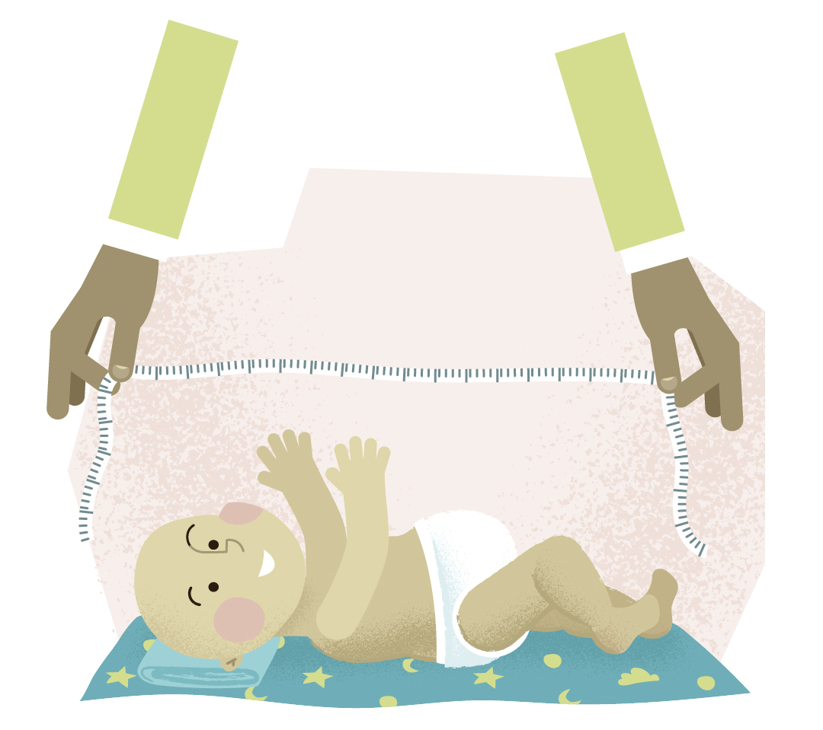
Recumbent/Supine length (<2 years of age)
COMMON MISTAKES
Measuring a child without the help of a second person
Child is unrestrained and free to move around
Child is measured by straightening one leg only
A measuring tape is used
Both legs are not stretched/straight
The surface under the child’s back is not flat
The child is facing sideways
Nappy has not been removed
The lower board of the measuring equipment (e.g., infantometer, measuring board) is not flat and parallel against the soles of the child’s feet
©

Slide 4
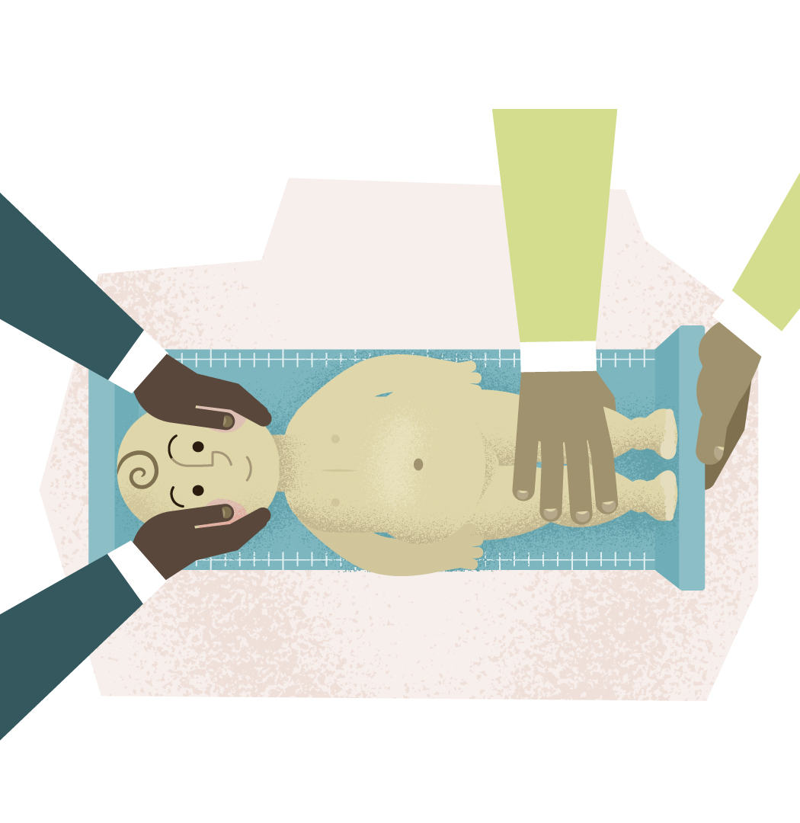

Recumbent/Supine length (<2 years of age)
CORRECT PROCEDURE
Use well-maintained and regularly calibrated (once a year or as needed) equipment
Remove clothes, including the nappy, place infant lying flat on their back
Two persons are needed – one to hold the head steady, the other to hold the legs straight down
First person
Holds the head against the fixed headboard of the infantometer, with child facing straight up
Second person
Straightens trunk and legs and holds them down and firmly
Positions feet with the soles parallel to the foot board
Brings the footboard into contact with the soles of both feet held firmly in place. Ideally, both legs should be straight with the ankles at the right angle of the legs and the toes pointing upwards
Records length to nearest millimeter
Resource:
How to measure length

Slide 5
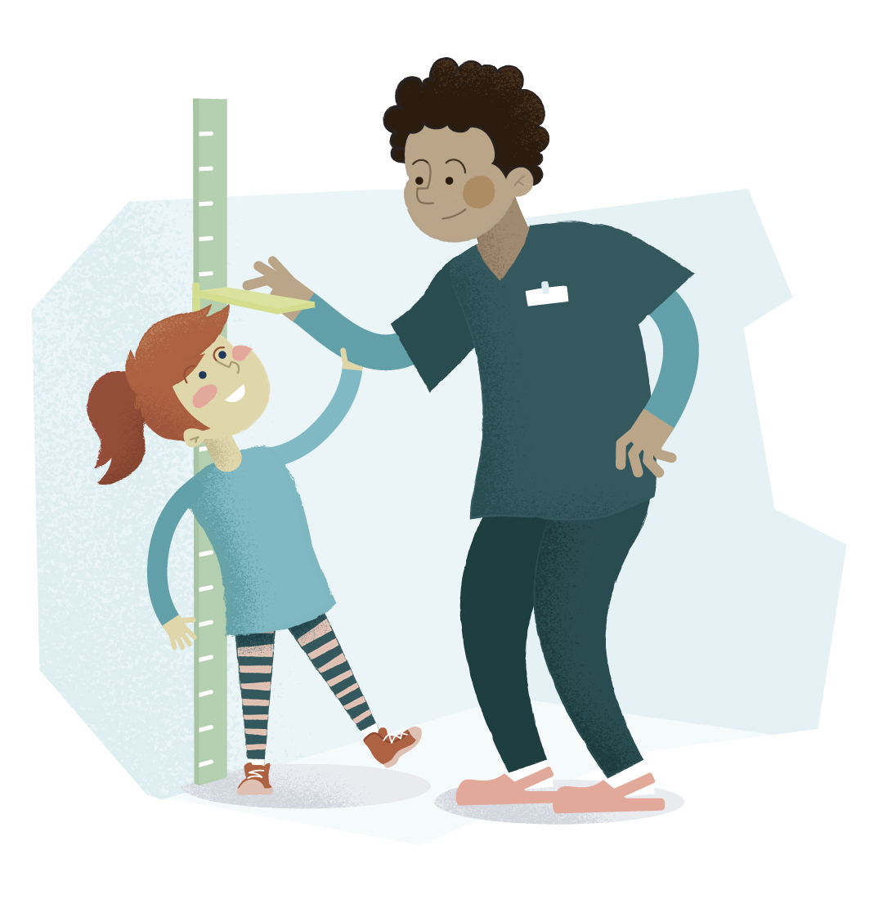
Standing height (>2 years of age)
COMMON MISTAKES
Child has shoes on
Child is standing on toes
Heels and legs are apart
Knees are not fully extended
Child is fully dressed
Child supports him/herself on furniture/caregiver/person who is taking the measurement
Child’s feet are placed one behind the other
Child is not standing straight
Child’s head is not in Frankfort plane
Child’s head is raised up or down

Slide 6
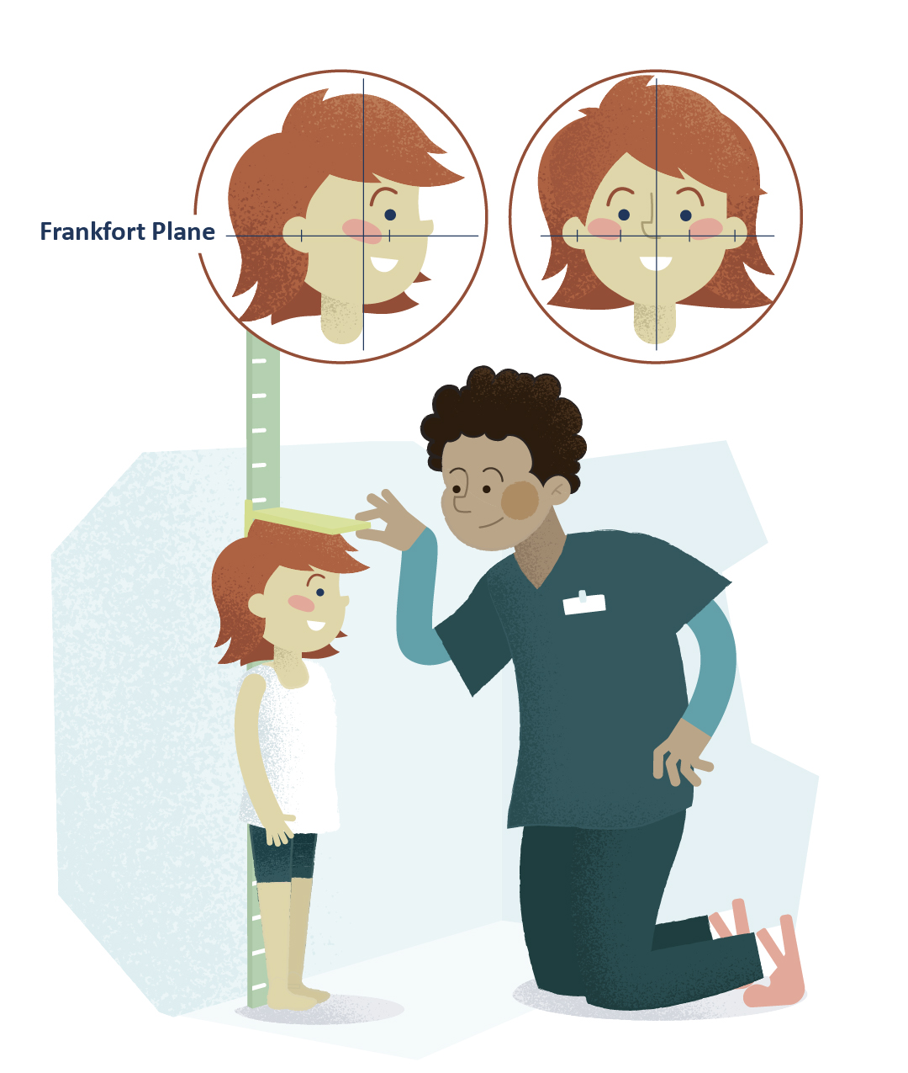

Standing height (children >2 years of age who can stand straight)
CORRECT PROCEDURE
Use a well-maintained and regularly calibrated (once a year or as needed) equipment
Remove heavy clothing (e.g., jackets, jumpers), shoes, thick socks and any hair accessories or hats/caps
Child should be standing upright, with feet together, heels, buttocks and shoulder blades touching the equipment vertical board or wall
Make sure arms are relaxed, legs straight, feet flat and next to each other
Bring the head horizontally into the Frankfort plane position
Ensure the measuring headboard rests firmly on the child’s head
Record height in centimeters and round to nearest millimeter
Resource:
How to measure height

Slide 7
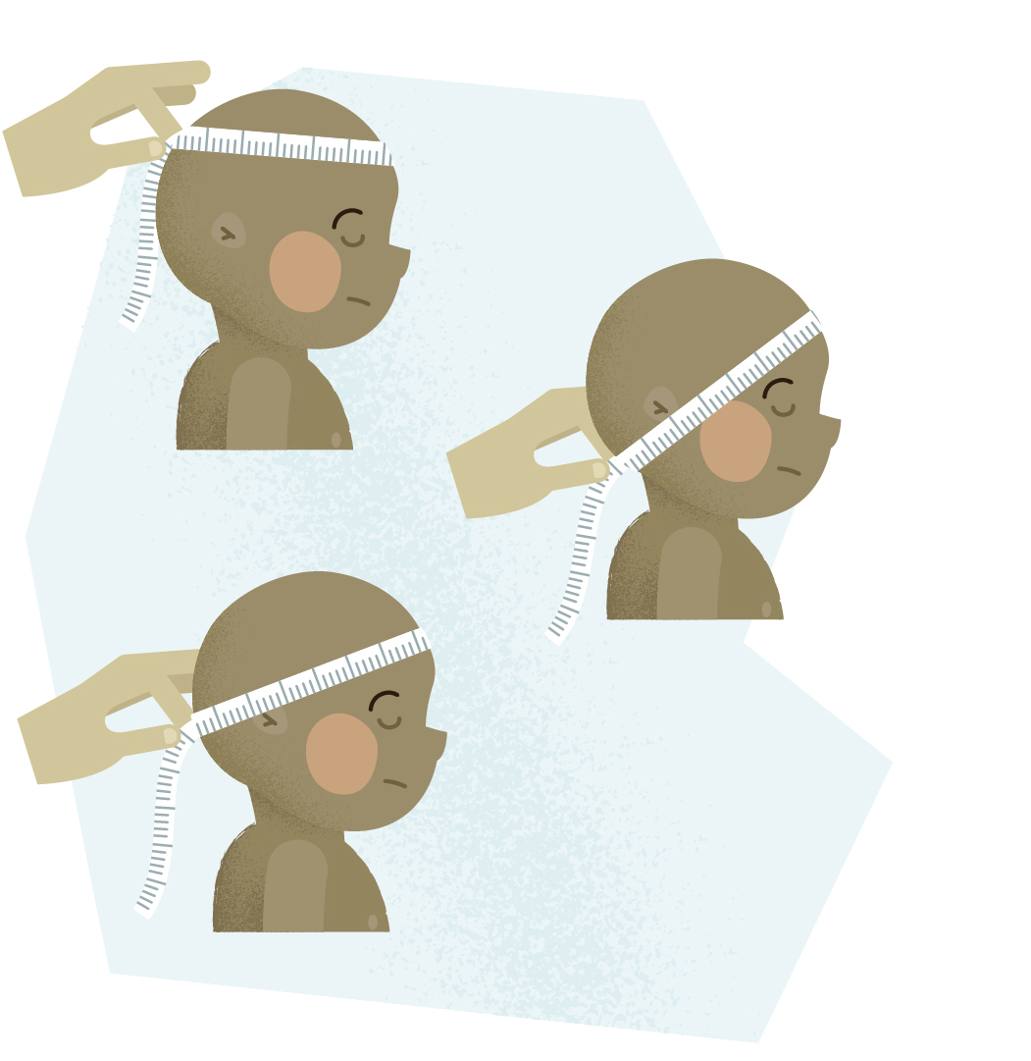
Head circumference
COMMON MISTAKES
Measuring tape is too high above the eyebrows, ears or both
Use of a non-flexible or stretching measuring tape
Tape is too low/too high at the back of the head
Tape runs over the ears

Slide 8
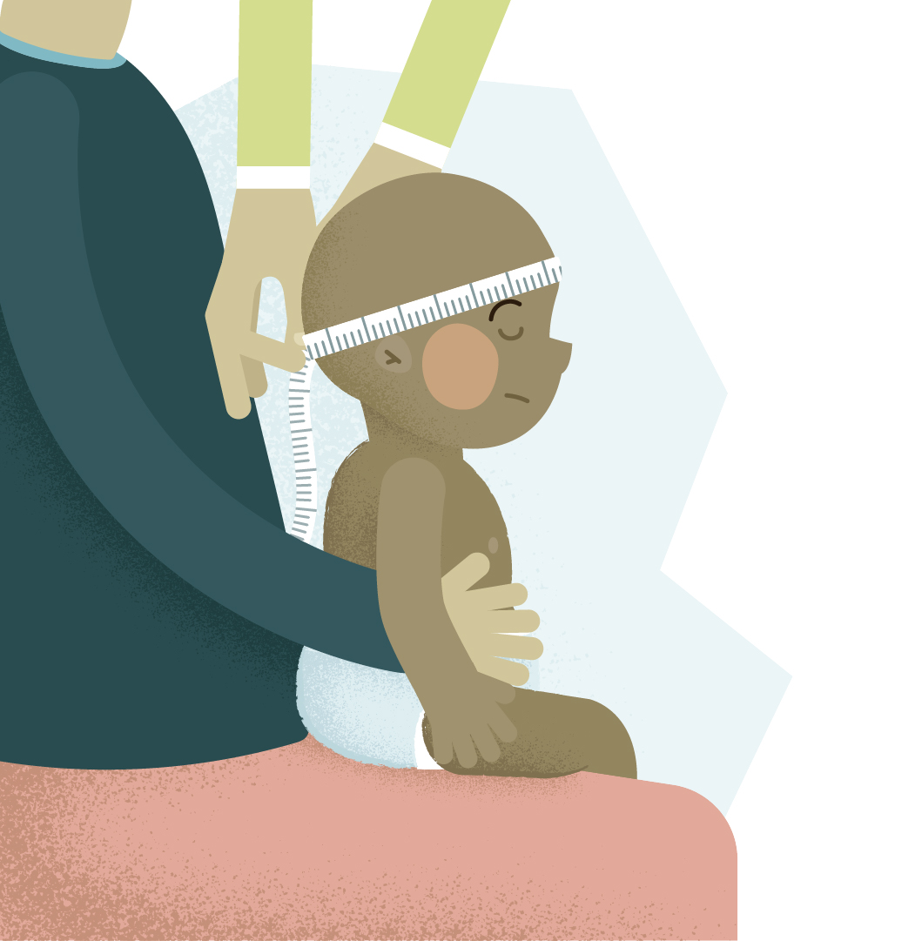

Head circumference
CORRECT PROCEDURE
Take a flexible, non-stretch tape to measure the head circumference
Remove hairpins and headbands or other accessories from head
Sit the infant on the caregiver’s lap
Hold the infant still during the measuring process
Pass the tape around the head and anchor it over the eyebrows
Check the tape passes just above the ears and over the bony protrusion on the back of the head
Pull firmly to compress the hair and skin but not to the point of causing discomfort to child
Take the reading rounding up to the nearest millimeter
Repeat measurement and if difference > 0.5 cm, a third measurement should be obtained. Calculate the average of the three
Resource:
How to measure head circumference

Slide 9
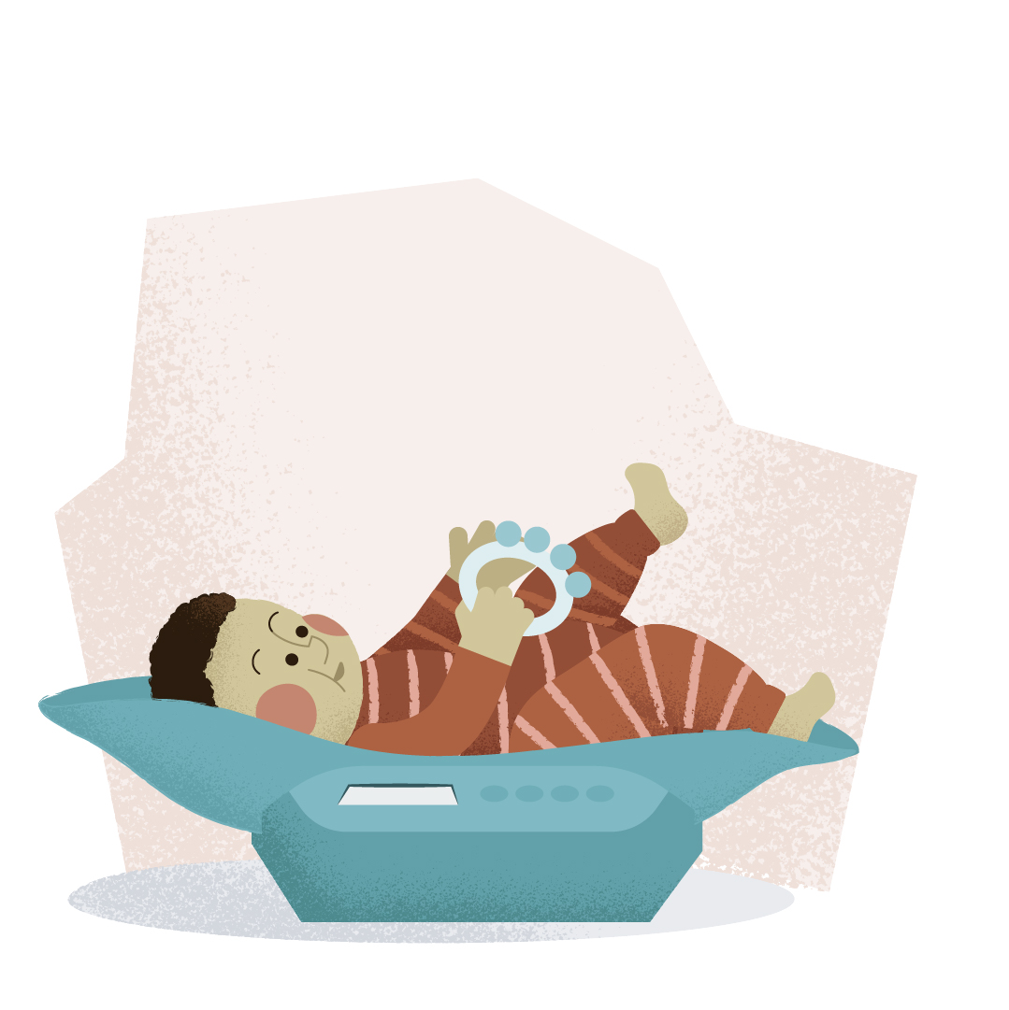
Weight of an infant (<2 years of age)
COMMON MISTAKES
Child measured dressed
Child measured in nappies (diapers)
Child’s weight measured by supporting the child
Child’s weight measured with toys in hands
Child’s legs or hands touching table (on which scale is set on)
or wall
Scale is positioned on a soft surface (e.g., mattress of a bed)

Slide 10
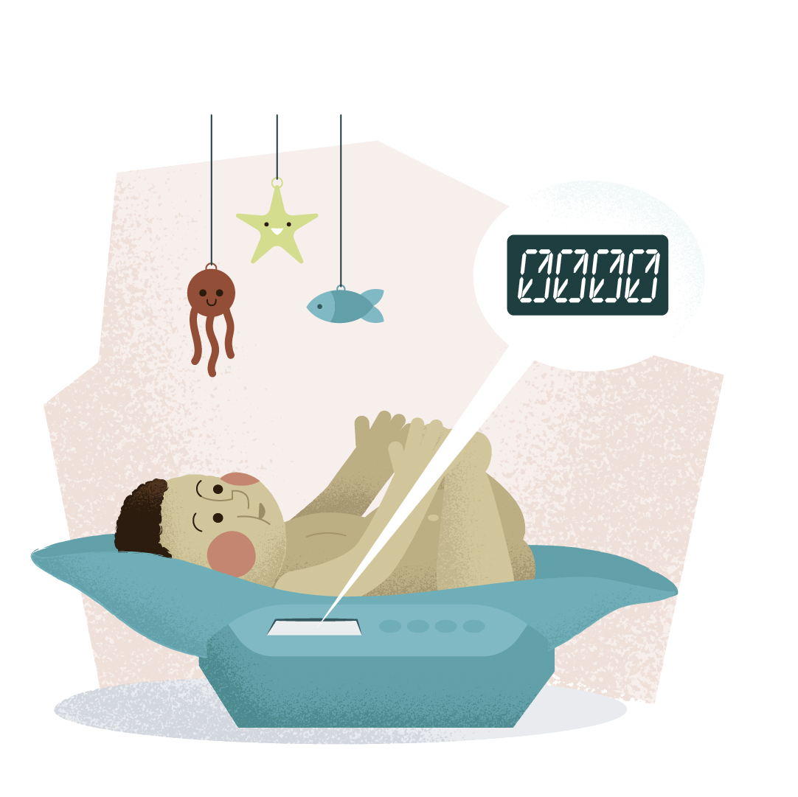

Weight of an infant (<2 years of age)
CORRECT PROCEDURE
Use well-maintained and regularly calibrated (once a year or as needed) equipment
The scale should weigh to the nearest 20 grams (best use Class III scales)
Set the scale at zero prior to weighing
Place the scale on a hard horizontal surface
Weigh the child naked, ideally before a feed/meal
Resource:
How to weigh children

Slide 11
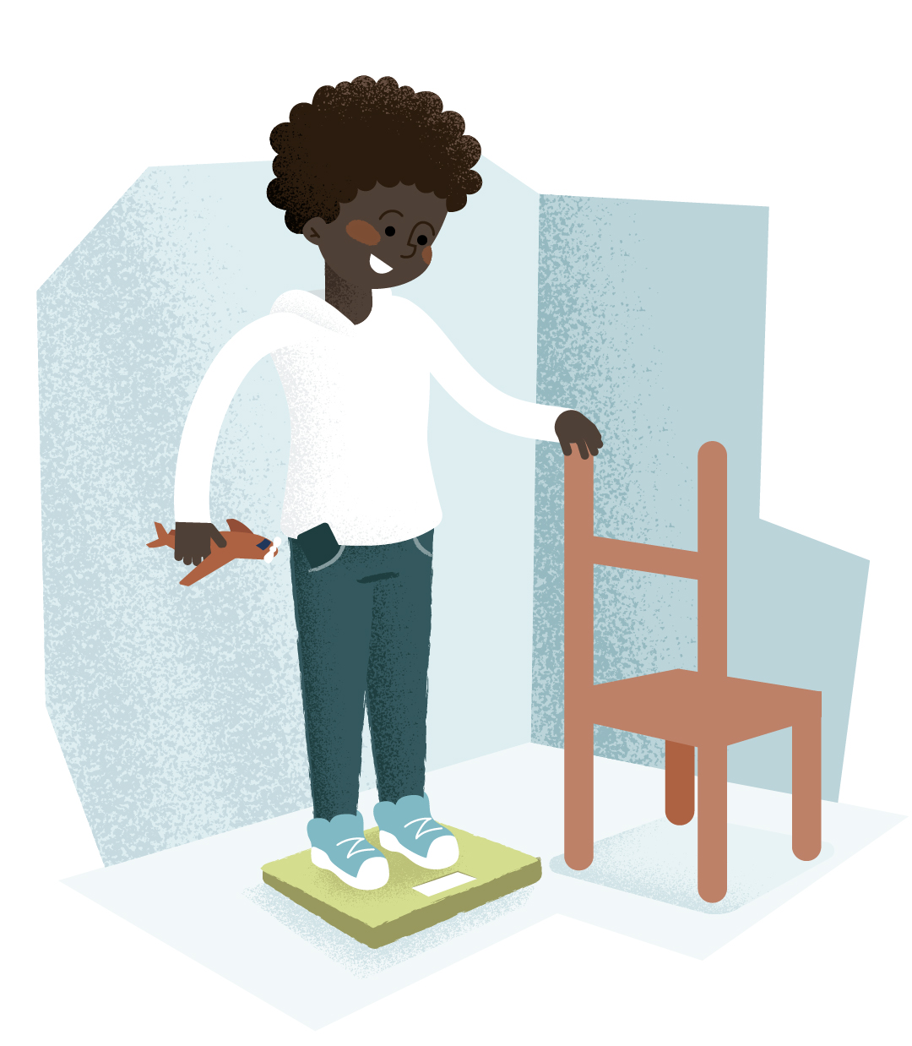
Weight of a child (>2 years of age)
COMMON MISTAKES
Child has shoes on
Child is fully dressed and has accessories in pockets (mobile phone, keys), toys in hands
Child supports him/herself on furniture/wall/caregiver or person who is taking the measurement
Scale is too close to the wall and child leans against the wall
Scale is on uneven or soft (e.g. carpet) surface

Slide 12
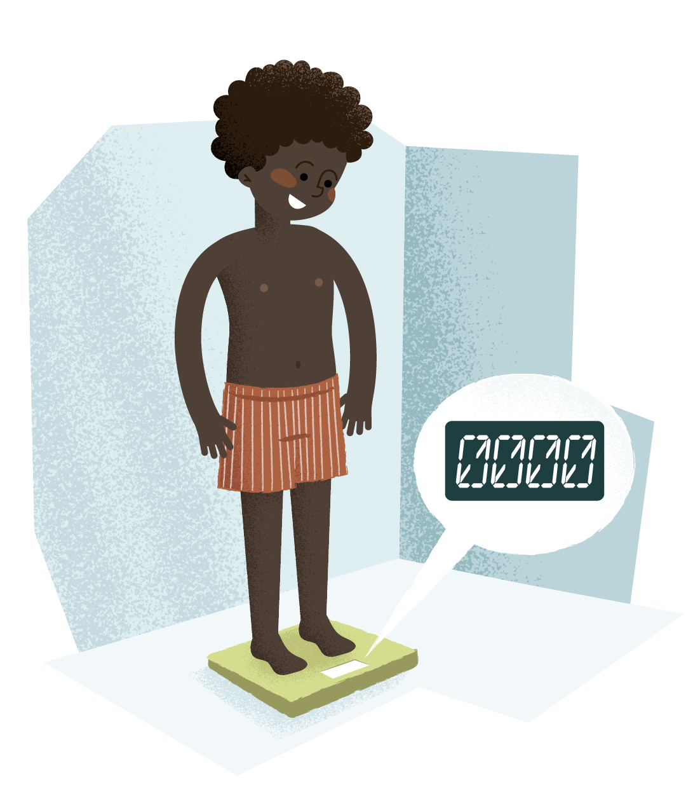

Weight of a child (>2 years of age)
CORRECT PROCEDURE
Use well-maintained and regularly calibrated (once a year or as needed) equipment
The scale should weigh to the nearest 100 grams (best use Class III scales)
Remove shoes, empty pockets, child wears minimal light clothing (e.g., underwear)
Check the digital screen on the scale is set to zero
Ask the child to stay still
For sitting-scale, feet should rest on the bar, not touching
the floor
Resource:
How to weigh children

Slide 13
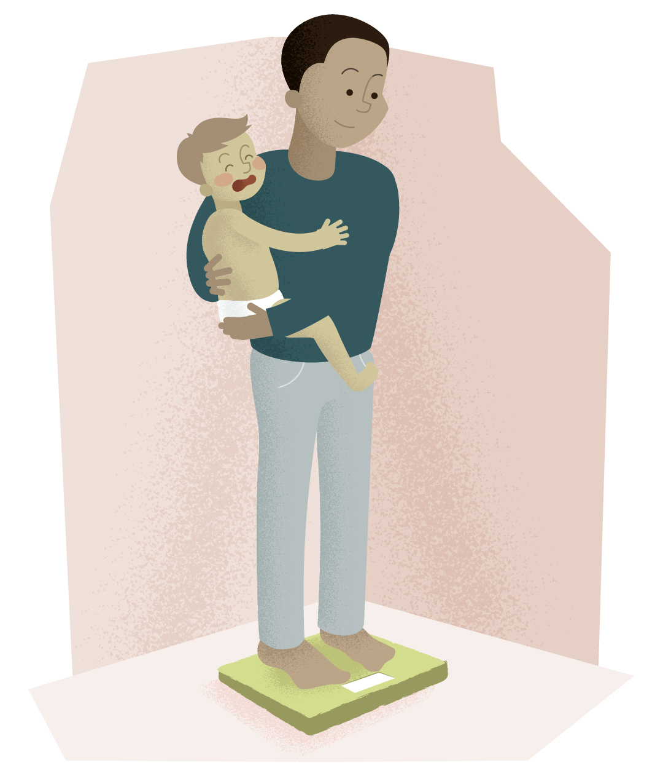

Weight of a child with disabilities or if uncooperative
CORRECT PROCEDURE
The measurement is taken with the help of a caregiver
Weigh the caregiver first and note the measurement down
Child should be naked or wearing minimal clothing
Give the child to the caregiver on the scale
Ask the caregiver to stand still
Note down the combined weight measurement
Subtract the caregiver’s weight from the combined weight
For disabled children use a hoist weighing scale if available
Resource:
How to weigh uncooperative children

Slide 14
Plotting of anthropometric measurements
Anthropometric measurements should be plotted on appropriate reference charts and interpreted considering previous measurements and the clinical scenario of the child
A practical approach to identifying pediatric disease-associated undernutrition is provided in the position statement from the ESPGHAN Special Interest Group on Clinical Malnutrition “Hulst et al JPGN 2022 doi: 10.1097/MPG.0000000000003437”

Slide 15


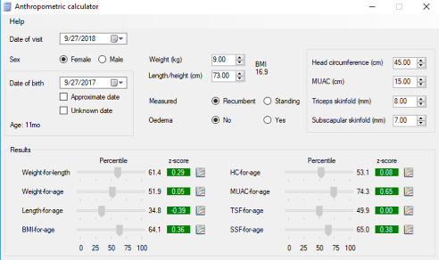
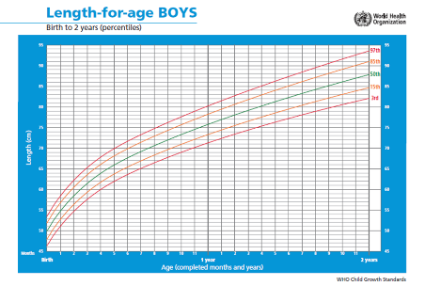
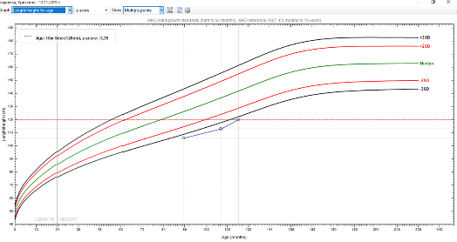
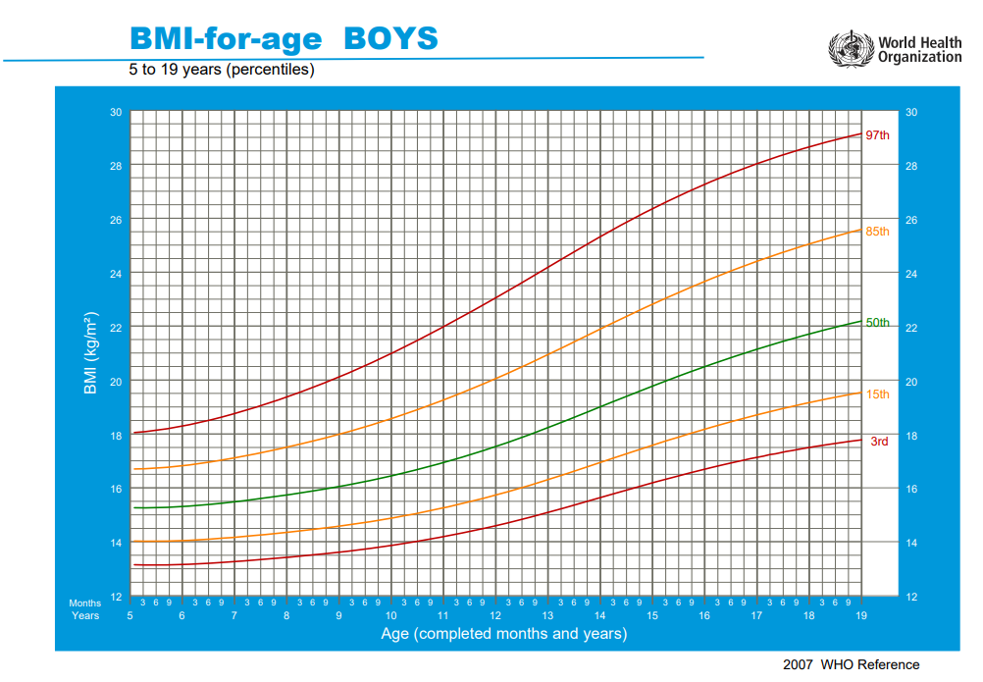

Additional Resources
WHO training course
https://www.who.int/tools/child-growth-standards
WHO video resources
WHO Training Course | MGRS Anthropometry Training Video – YouTube
WHO child growth standards
https://www.who.int/tools/child-growth-standards/standards
WHO software resources
https://www.who.int/tools/child-growth-standards/software
https://www.who.int/tools/growth-reference-data-for-5to19-years/application-tools https://www.healthforallchildren.com/shop-base/shop/software/lmsgrowth/

Slide 16
Disclaimer
ESPGHAN takes no responsibility for the accuracy of the translation of the original English version.

