Slide 1
Quality of care initiative of ESPGHAN:
Acquisition and reporting of anthropometric measurements in routine practice from 114 hospitals in 28 European countries
Notes:
Dear .... Thank you for your kind introduction.

Slide 2

OUR TARGET
143 Million
Children & Adolescents
from 0 - 17 years of age are living in
Europe in 2020

Slide 3

WHO Definition of Quality of Care
“The extent to which health care services provided to individuals and patient populations improve desired health outcomes. In order to achieve this, health care must be safe, effective, timely, efficient, equitable and people-centred.”

Slide 4

WHO Definition of Quality of Care
Safe. Delivering health care that minimizes risks and harm to service users, including avoiding preventable injuries and reducing medical errors.
Effective. Providing services based on scientific knowledge and evidence-based guidelines.
Timely. Reducing delays in providing and receiving health care.
Efficient. Delivering health care in a manner that maximizes resource use and avoids waste.
Equitable. Delivering health care that does not differ in quality according to personal characteristics such as gender, race, ethnicity, geographical location or socioeconomic status.
People-centred. Providing care that takes into account the preferences and aspirations of individual service users and the culture of their community.

Slide 5

WHAT IS NEEDED?
Competent and motivated health-care professionals
Effective communication
Community engagement

Slide 6
Assessment of Quality of Care
Structure
Process
Outcome
Staff
Equipment
Supplies
Guidelines
Communication
Interaction
Investigation
Treatment
Counselling
Mortality Morbidity
Satisfaction
Quality measures, quality indicators, key performance indicators, clinical quality measures

Slide 7
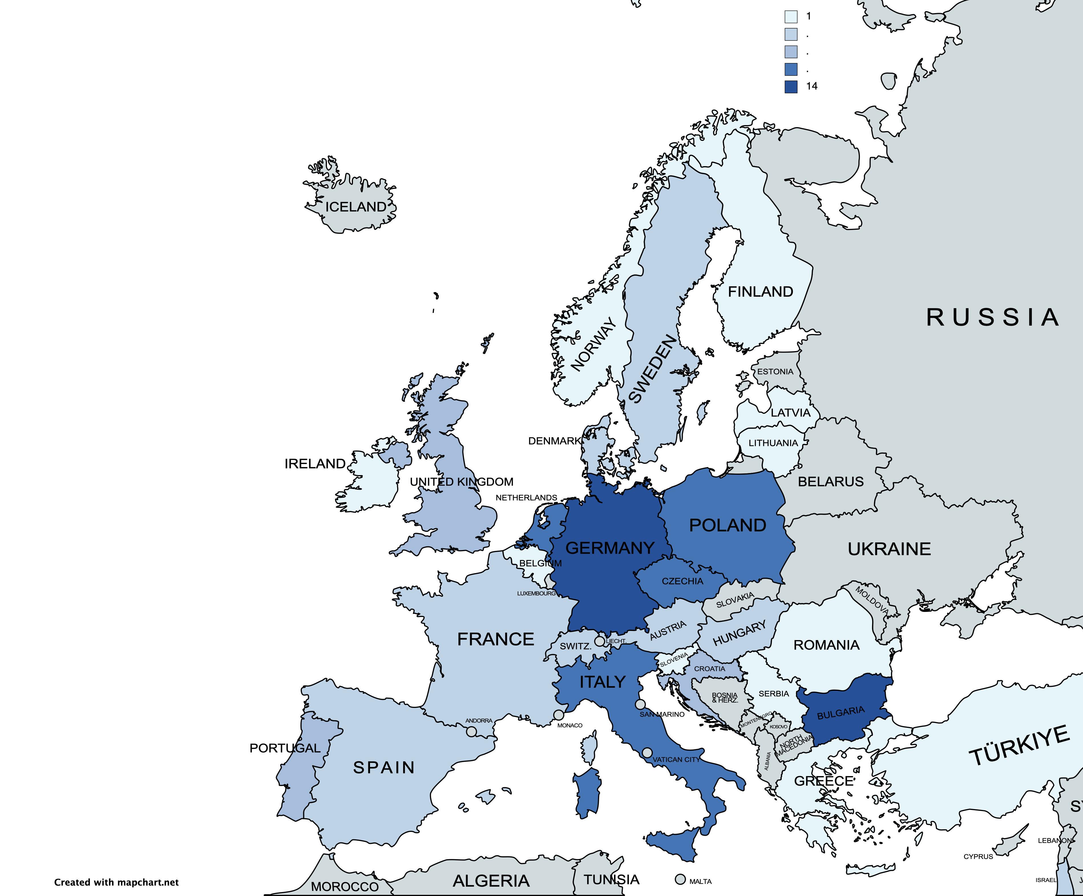
Quality of Care Initiative of ESPGHAN
Mission: To evaluate the implementation of evidence-based guidelines in daily practice
and to provide educational material to harmonize QoC in paediatric GHN patients
Network until October 2023: 114 hospitals in 28 countries
  67% academic, 33% non-academic
  63% certified for PGHN training
  92% with at least one paediatric gastroenterologist
Tools: pseudonymized online survey
via a secure data platform of ESPGHAN
Questionnaires: hospital characteristics
& specific topics
Notes:
Espghan provides many excellent evidence based guidelines and position papers for patients with different GI, liver or nutritional disorders
The QoC intitiative aims to survey the implementation of these guidelines, to identify deficits, provide feedback and educational material and to evaluate again to look for improvement
Pediatric hospitals all over Europe were recruited, by April , 114 had joined.
Two thirds are academic hospitals,
63% are certified for training, and 92% had at least one trained Pediatric gastroenterologist in the team
The survey was performed pseudonymized on a secured data platform of ESPGHAN. Participants provided extensive information on their hospital, thereafter information on specific topics

Slide 8
Focus of 2022: Anthropometric measurements
Aims
To assess:
Nutritional care in participating hospitals
Performance and documentation of anthropometric measurements
Methods
Questionnaires on resources and tools in nutritional care
Practical tasks reviewing documentation in patient files and discharge letters (at least 8 cases, no patient data)
                Litwin et al. J Ped Gastroenterol Nutr.2024- doi:10.1002/jpn3.12136
Notes:
The first topic focussed on the performance and documentation of anthropometric measurements.
First we assessed by questionnaire the resources, tools and estimates in the performance of anthropometry,
Practical tasks reviewed documentation in patients files - discharge letters (at least 8 cases per hospital, without assessing individual patients data)
In the second step we surveyed the real performance in at least 8 randomly chosen patients with Gi and general pediatric disorders.

Slide 9
Selected results of Survey on Nutritional Care / Nutrition Service (questionnaire filled by consultant)

Slide 10
Nutritionist/Dietitian available for GI or liver paediatric patients
                Litwin et al. J Ped Gastroenterol Nutr.2024- doi:10.1002/jpn3.12136
Notes:
9% of hospitals have no dietician, and another 12 % only for selected patient groups.

Slide 11
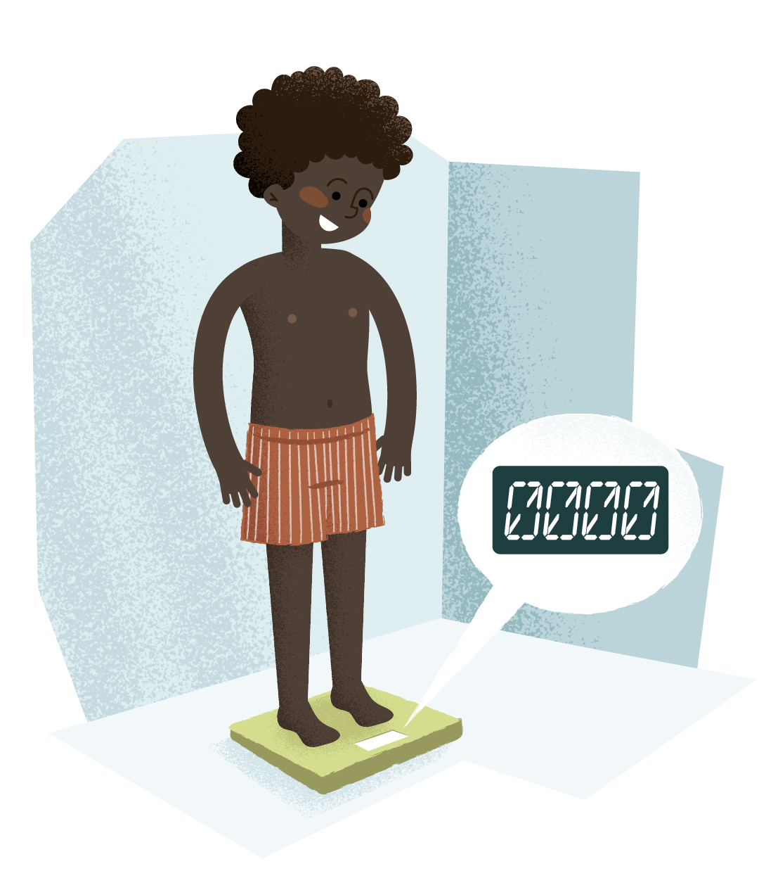
Standard operation procedures to measure weight and height
                Litwin et al. J Ped Gastroenterol Nutr.2024- doi:10.1002/jpn3.12136
Notes:
Because of limited time I present only a few selected results of deficits of quality of care which we have identified.
E.g.
15% of the hospitals have no policy how to assess and document anthropometric data

Slide 12
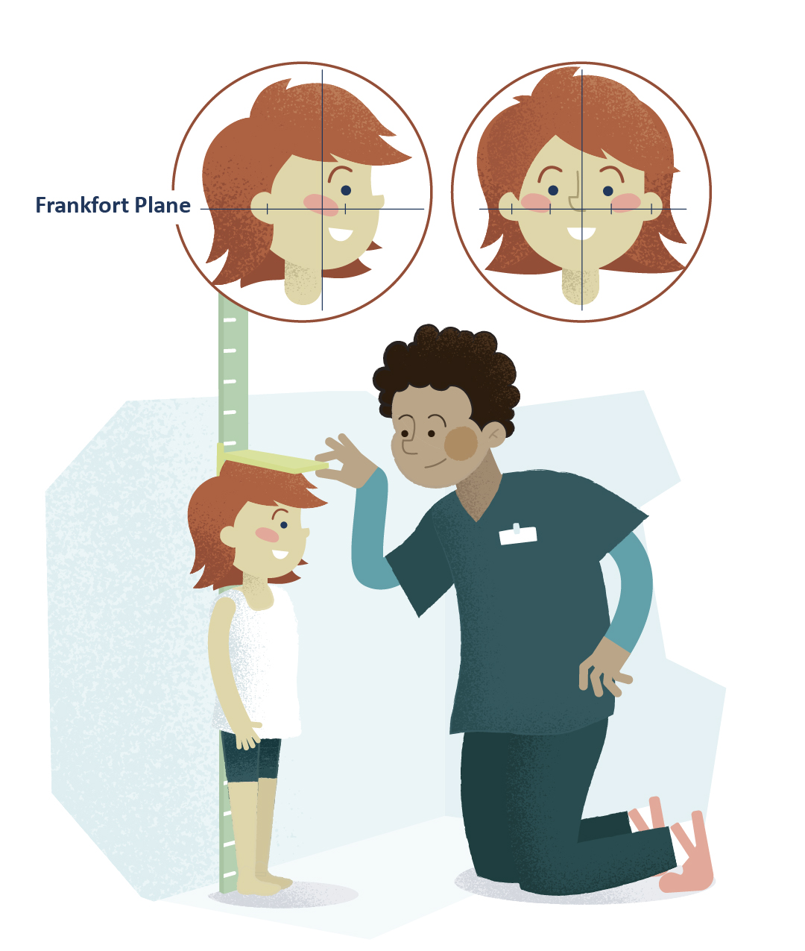
Training for nursing staff in measuring weight and height/length
                Litwin et al. J Ped Gastroenterol Nutr.2024- doi:10.1002/jpn3.12136
Notes:
At least 15% do not provide training for nursing staff how to correctly perform anthropometric measurement

Slide 13
Availability of stadiometer fixed to the wall
                Litwin et al. J Ped Gastroenterol Nutr.2024- doi:10.1002/jpn3.12136
Notes:
A wall-mounted stadiometer to measure standing height was not available in 10% of hospitals.

Slide 14
Equipment available to measure sitting weight
                Litwin et al. J Ped Gastroenterol Nutr.2024- doi:10.1002/jpn3.12136
Notes:
33% have no scale to measure sitting weight for children unable to stand on the scale.

Slide 15

Tool to measure infant length
                Litwin et al. J Ped Gastroenterol Nutr.2024- doi:10.1002/jpn3.12136
Notes:
For measurement of the length of infants, 14% have no rigid measuring board available and routinely use a measuring tape instead.

Slide 16
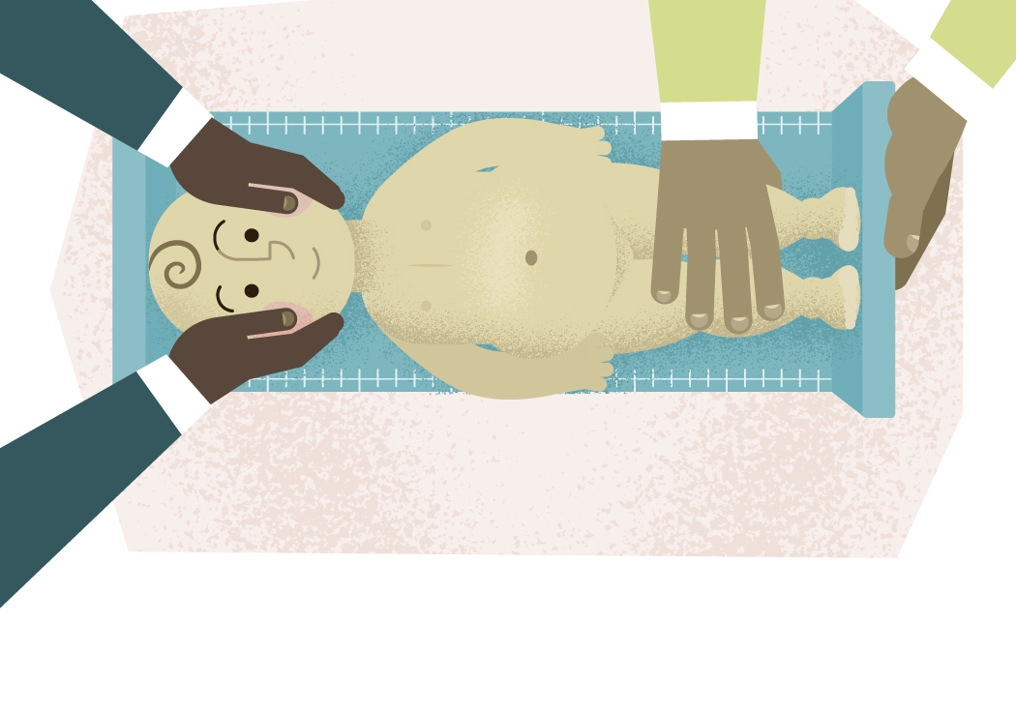
Measurement of infant length done by two people
                Litwin et al. J Ped Gastroenterol Nutr.2024- doi:10.1002/jpn3.12136
Notes:
in 50% of hospitals infant length was measured by only one and not two healthcare professionals, as recommended in order to fix the infant properly.

Slide 17
Selected results of Practical Tasks on Documentation of Anthropometric Data (review of source data such as files and discharge letters)
                Litwin et al. J Ped Gastroenterol Nutr.2024- doi:10.1002/jpn3.12136

Slide 18
Practical Task A
Participating Hospital were ask to review and report whether
  anthropometric data (weight, height, weight percentiles and height percentiles) were documented in the files of eight randomly chosen current inpatients
  from two different wards, including four patients with GI or liver disease and four general paediatric patients (excluding neonatal, intensive care and oncology wards)
                Litwin et al. J Ped Gastroenterol Nutr.2024- doi:10.1002/jpn3.12136

Slide 19
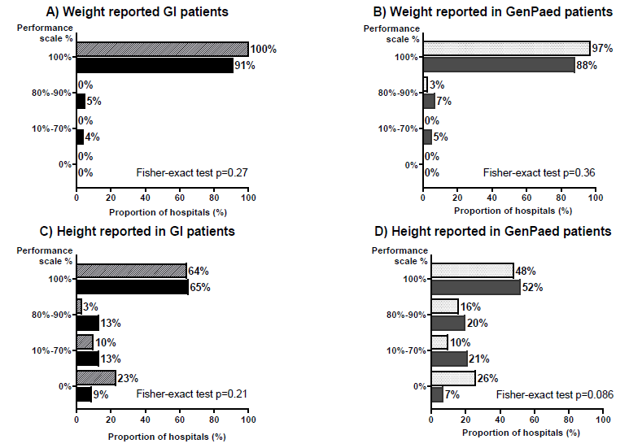
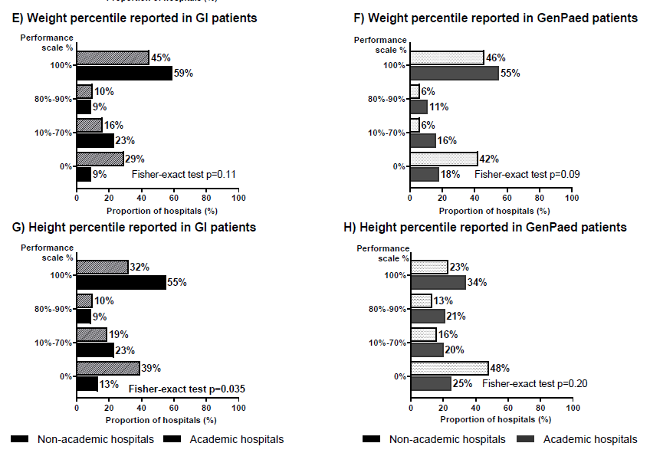
Weight, height and their percentiles routinely reported in current GI and General Paediatric inpatients by Type of Hospital
Academic Hospitals, Non-academic Hospitals
                Litwin et al. J Ped Gastroenterol Nutr.2024- doi:10.1002/jpn3.12136

Slide 20
Practical Task B
Participating Hospital were ask to review and report whether
  anthropometric data (weight, height, weight percentiles and height percentiles) were documented in discharge letters of eight randomly chosen inpatients (discharged 2 and 6 months ago)
  from two different wards, including four patients with GI or liver disease and four general paediatric patients (excluding neonatal, intensive care and oncology wards)
  Results from reviewed letters (real data) were compared with estimates provided by the consultant in the questionnaire before Task B was performed
                Litwin et al. J Ped Gastroenterol Nutr.2024- doi:10.1002/jpn3.12136

Slide 21
Weight routinely reported in letters versus estimates
estimated (questionnaire) vs reviewed from random discharge letters (practical task B)
GI or liver patients
General paediatric patients
                Litwin et al. J Ped Gastroenterol Nutr.2024- doi:10.1002/jpn3.12136
Notes:
In the next slides we compare the estimates – the light bars- given in the questionnaires, mostly by a consultant - with the reports in the discharge letters - the dark bars – assessed in practical tasks from 8 randomly chosen patients.
On the left the results for randomly chosen GI, on the right for general ped patients.
For weight, for GI patients estimates and reported values did not differ significantly.
For general pediatric patients there was a trend for better estimation. In 14% of the letters no weight was reported .

Slide 22
Height routinely reported in letters versus estimates
estimated (questionnaire) vs reviewed from random discharge letters (practical task B)
GI or liver patients
General paediatric patients
                Litwin et al. J Ped Gastroenterol Nutr.2024- doi:10.1002/jpn3.12136
Notes:
For height, physicians` estimates on missing documentation was only 3% for both patients group. However, the discharge letters disclosed no height data in 14% of GI and even 28% of general patients.

Slide 23
Weight percentile routinely reported in letters versus estimates
estimated (questionnaire) vs reviewed from random discharge letters (practical task B)
GI or liver patients
General paediatric patients
                Litwin et al. J Ped Gastroenterol Nutr.2024- doi:10.1002/jpn3.12136
Notes:
With respect to documentation of weight percentiles, the estimation was too optimistic for both patients groups, with a thirds of the GI and half of the general patients having no values given in the discharge letters. Both being significant

Slide 24
Height percentile routinely reported in letters versus estimates
estimated (questionnaire) vs reviewed from random discharge letters (practical task B)
GI or liver patients
General paediatric patients
                Litwin et al. J Ped Gastroenterol Nutr.2024- doi:10.1002/jpn3.12136
Notes:
The results regarding reporting of height percentiles were very similar, although we consider particular in chronic patients changes or a drop in the percentage as particular important

Slide 25


Educational materials on anthropometrics
Available in many different languages on the ESPGHAN QoC website
Notes:
We provided a slide set with integrated videos on the performance of anthropometry - pointing out to common mistakes and thereafter showing the correct measurements.
The material have been sent to all participating hospitals after they finished their task, to train nursing staff, doctors and medical students.
The slides have been translated into 13 different languages.

Slide 26
Conclusions for practice
Correct measurement and documentation of weight, height, and also head circumference in infants and their percentiles is an essential part of quality of care, in both, healthy and diseased children.
The survey identified some shortcomings unrelated of academic or non academic hospital.
The caring physicians were often not aware of these deficits or overestimated the performance in their hospital compared to the real data.
Hospital staff should be informed on important results of their hospitals: What is perfect? Where is room for improvement and how to achieve this?
Notes:
In conclusion
Correct assessment of reporting of anthropometric data including percentils is important part of Qoc
Our survey identified some deficits, unrelated to the type of size of hospitals
Physicians were often not aware of them and appreciated the slide set to educate the teams
More projects will follow, like management of CD and elevated liver enzymes. We will report and hope the more hospitals will join.

